Slide 1
How to Search for Data
2019 AMOS Darwin
Kate Snow & Jingbo Wang

Slide 2
Geonetwork
CMIP Website
ESGF Site
CleF
Data Download Requests

Slide 3
Key Takeaways...
Know where to go to search for data hosted at NCI:
https://geonetwork.nci.org.au
The options available to access data
Remote access options
In-situ on filesystem
How to request to join data projects (for closed data collections)

Slide 4
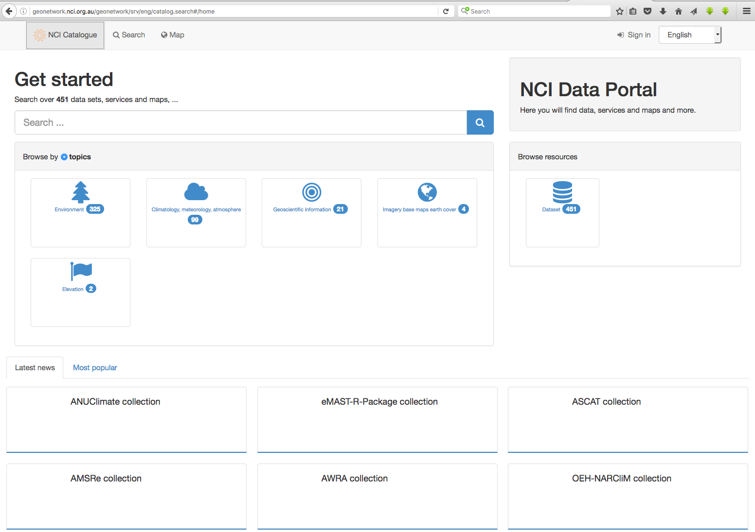
GeoNetwork catalogue: https://geonetwork.nci.org.au

Slide 5
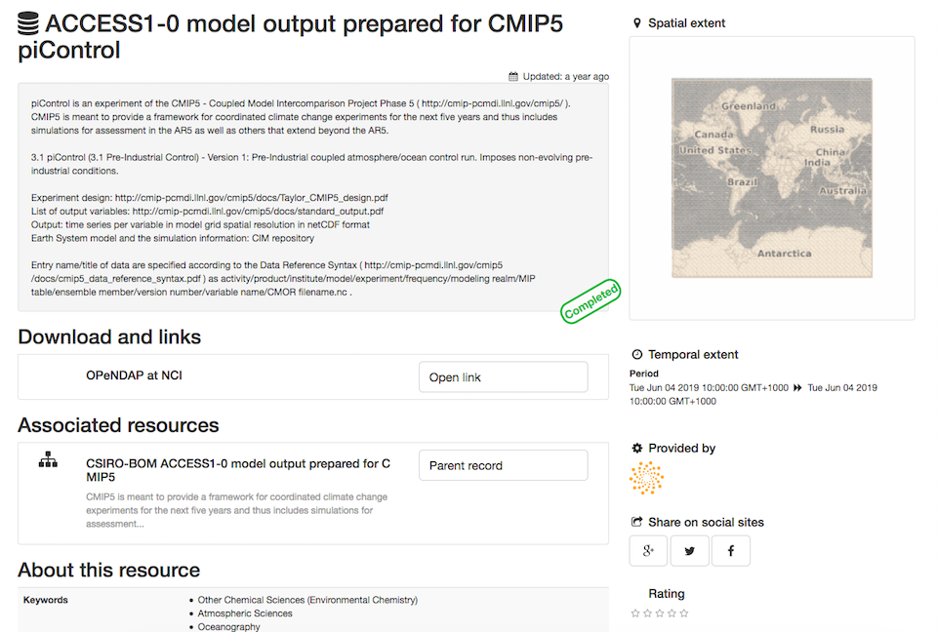
Accessing data
When searching and browsing data, published collections will have a direct link to NCI’s Data Services.
But what do we do from there?
(...we’ll get to this bit later in the next sections!)

Slide 6
Datasets are stored within data subcollections and collections as parent-child relationships.

Slide 7
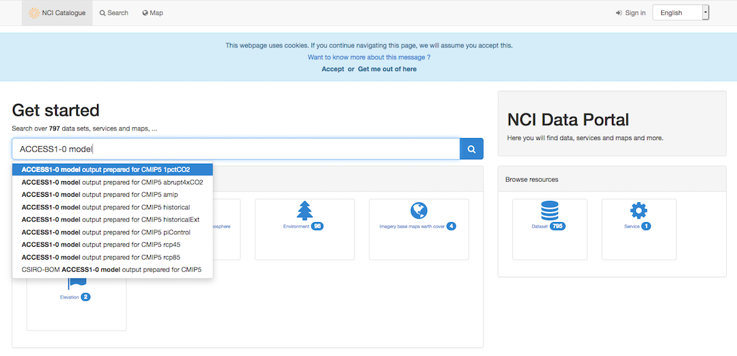
Exercise
Browse data catalogue for ARCCSS/CLEX datasets: https://geonetwork.nci.org.au
Try to searching “ACCESS1-0 model...”

Slide 8
Geonetwork
CMIP Website
ESGF Site
CleF
Data Download Requests

Slide 9
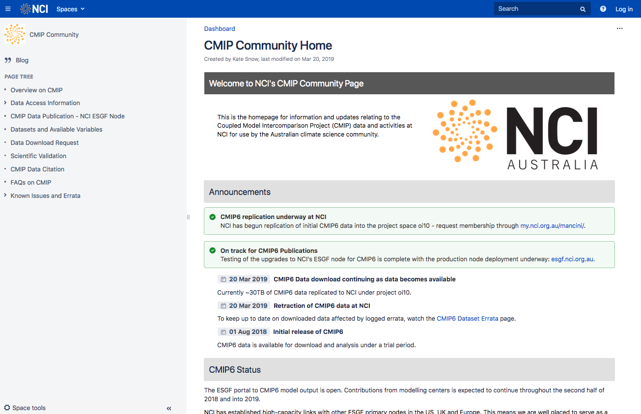
CMIP Community Site
https://opus.nci.org.au/display/CMIP/CMIP+Community+Home
Community information page on CMIP data. Includes announcements, user guides, data access information, etc.
Publicly viewable.
Central source of information for all CMIP relate activities at NCI.

Slide 10
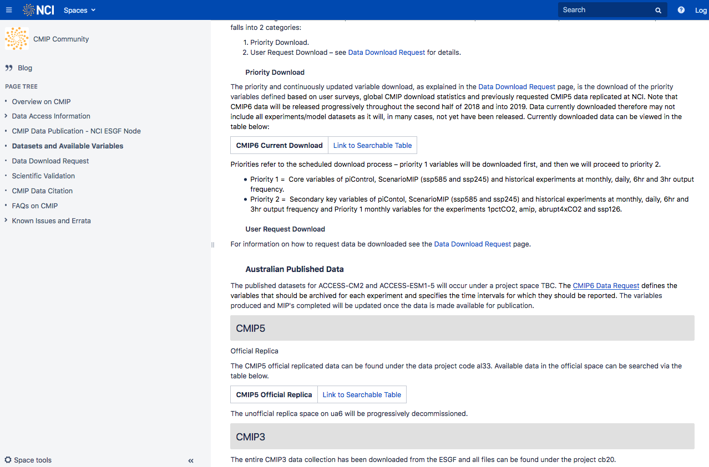
Available Data and Searchable Tables
Information on replica datasets downloaded to NCI is contained on the “Datasets and Available Variables” page.
Includes searchable tables updated weekly on data both downloaded and in the download queue.

Slide 11
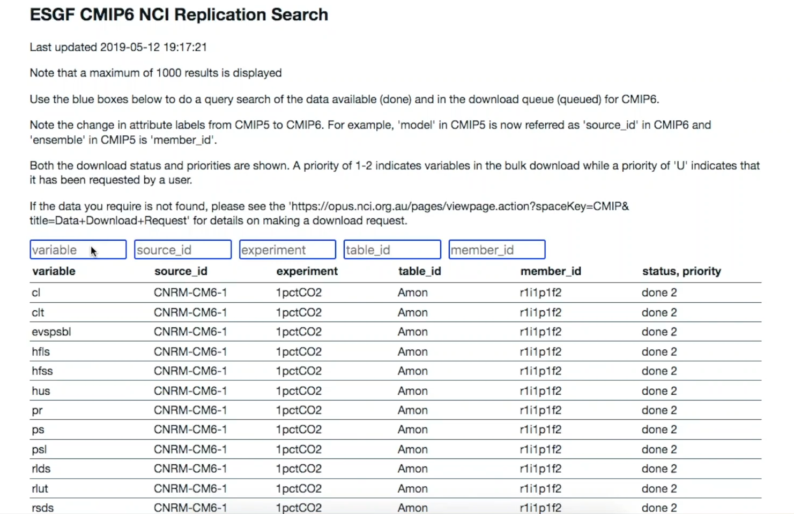
Demo
Table is updated weekly
Includes download status and priority
Relies on attribute search (more on CMIP attributes later).

Slide 12
Geonetwork
CMIP Website
ESGF Site
CleF
Data Download Requests

Slide 13

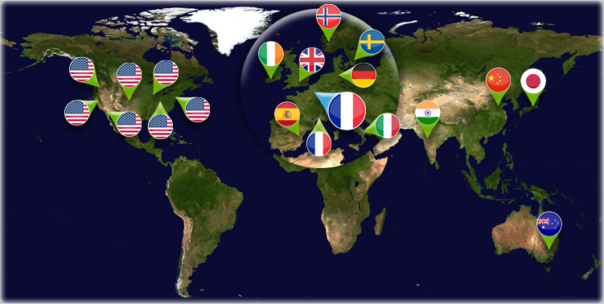
NCI ESGF Site
CMIP data is distributed via the Earth System Grid Federation (ESGF): a collaboration of internationally distributed data nodes.
NCI manages the ESGF Tier 1 data repository that serves the Australian climate science community.

Slide 14
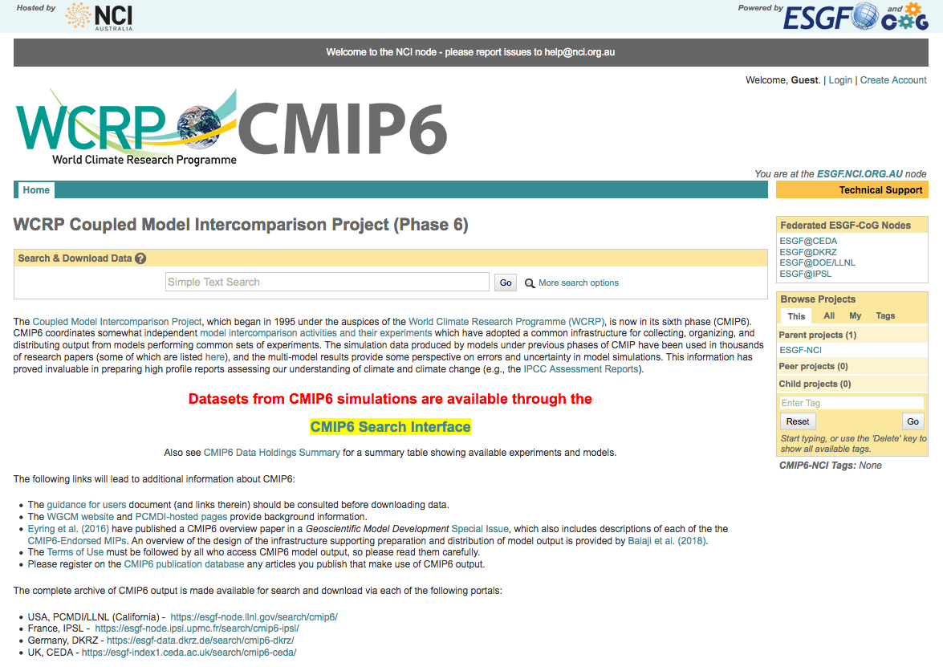
NCI ESGF Site
Data published via ESGF can be searched from the node sites.
https://esgf.nci.org.au/
Or just Google search “NCI CMIP5/6 ESGF”
Click to go to search interface

Slide 15
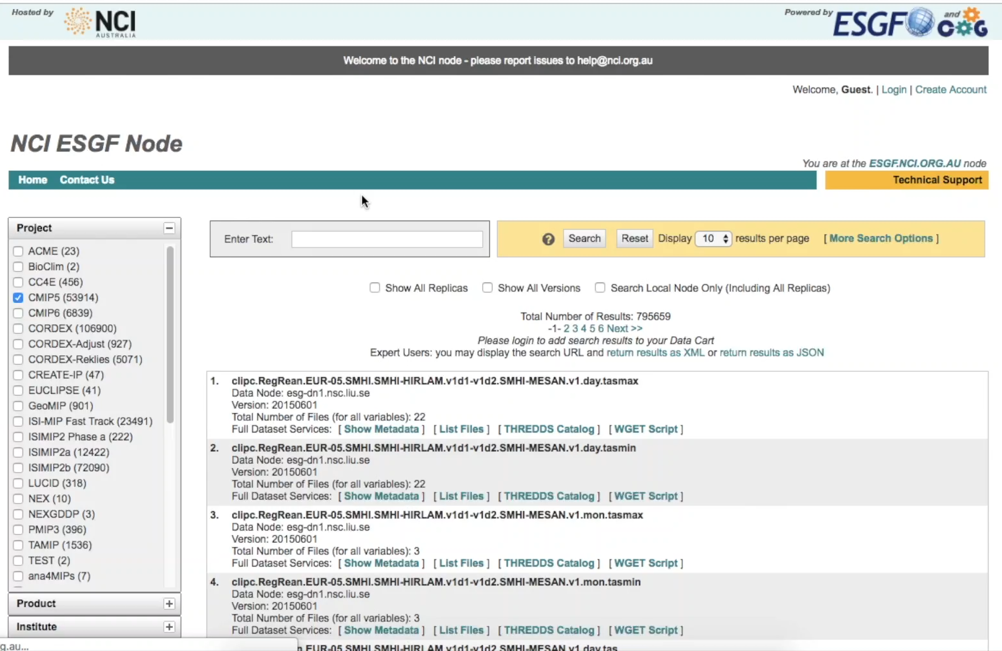
NCI ESGF Site
Keyword Search
Attribute search on LHS tabs
Search particular node publications/replicas
View metadata/THREDDS catalogue
View retracted data under “Show All Versions”

Slide 16
Geonetwork
CMIP Website
ESGF Site
CleF
Data Download Requests

Slide 17
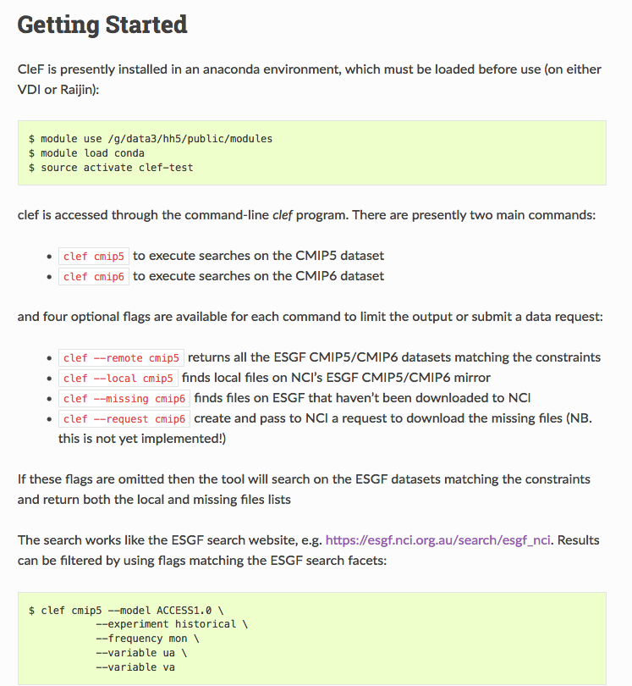
Climate Finder (CleF)
CleF is the Climate Finder tool developed by CLEX https://clef.readthedocs.io/en/latest/gettingstarted.html
Be aware that CleF is a tool under active development and changes/updates may occur.
Example to follow. Load the module.

Slide 18
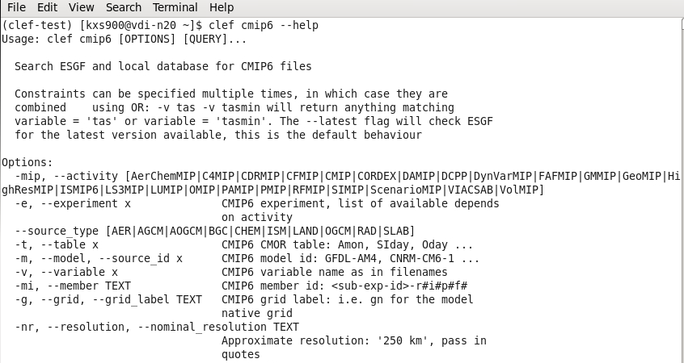
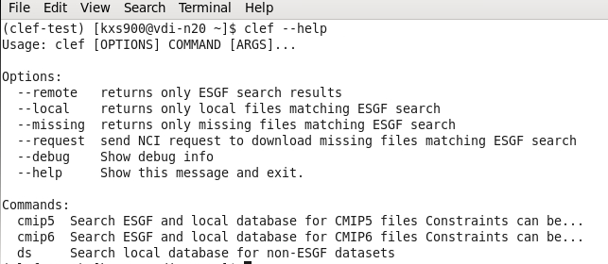
Climate Finder (CleF) Example
Returning help messages to list usage and available commands/parameters.

Slide 19
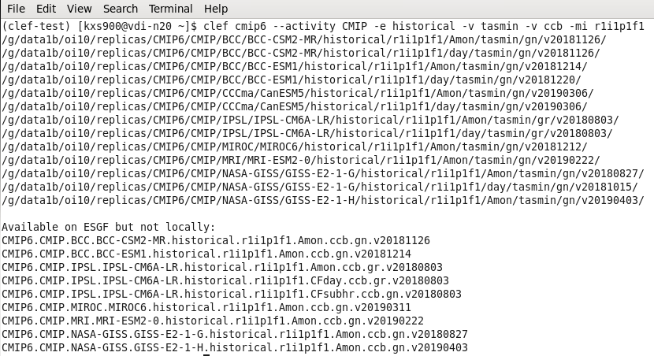
Climate Finder (CleF) Example
Searching for a specified dataset.

Slide 20
Geonetwork
CMIP Website
ESGF Site
CleF
Data Download Requests

Slide 21
Climate Finder (CleF) Data Download Request
Once you have completed a search using the CleF tool, a data download request may be made if you have the determined the data to be of high priority and required for your research.
To submit a request for the data to be downloaded, add “--request”
So from previous example, it becomes:
$ clef--request cmip6 --activity CMIP -e historical -v tasmin -v ccb -mi r1i1p1f1
Requests from the VDI will be emailed to help@nci.org.au. Requests from Raijin need to be manually emailed.

Slide 22
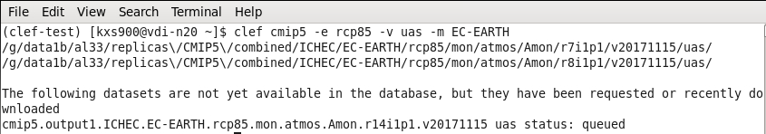
Climate Finder (CleF) Data Download Request
You can see the data being downloaded using CleF which also contains the information on data in the download queue.
Further CleF training: https://climateextremes.org.au/cms-training-clef-discovering-cmip6/

Slide 23
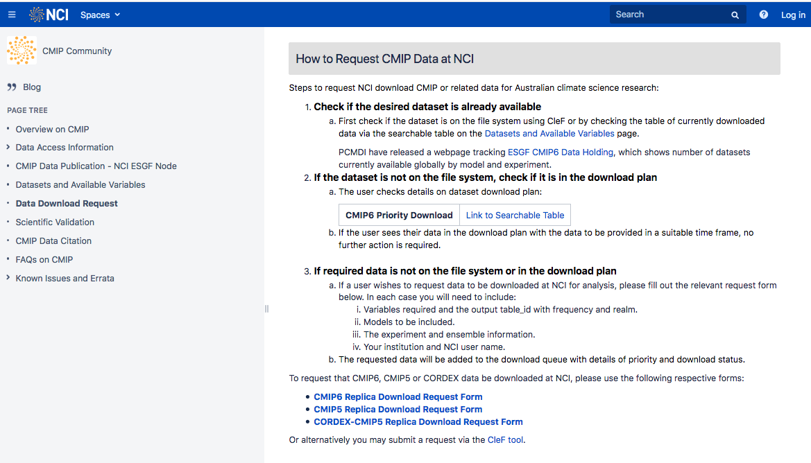
CMIP Website Download Request
You can also request to have data downloaded from the CMIP Community Site
Ensure you have searched for the data BEFORE making a download request
Can request CMIP5, CORDEX and CMIP6 data.

Slide 24
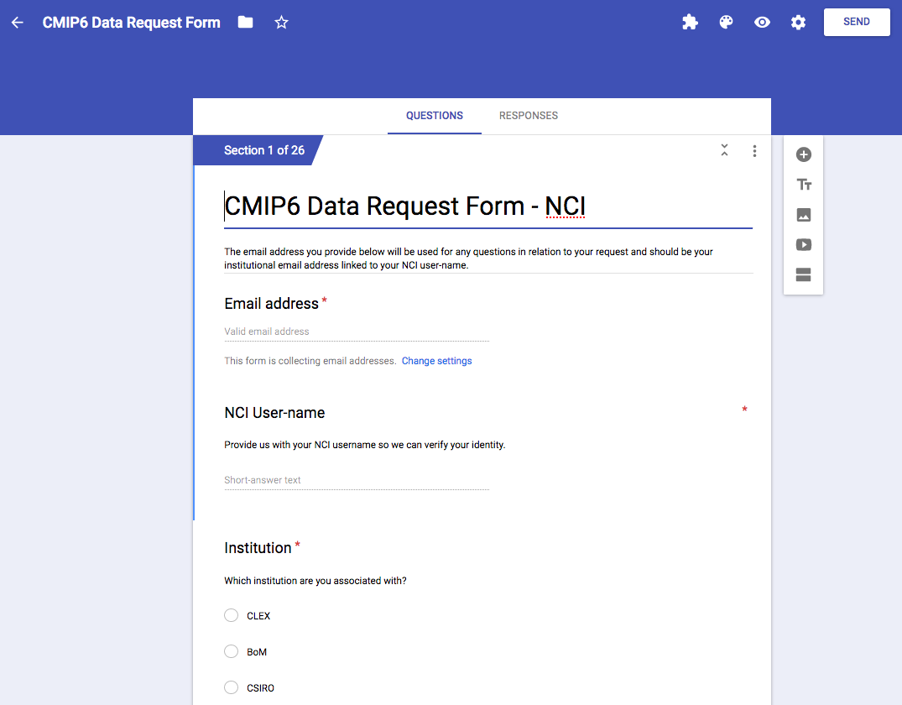
CMIP Website Download Request
Request is via a Google Forms sheet that is emailed to help@nci.org.au once complete.
Time for download may vary depending on how many other downloads are in the queue, how large the download is, and where it is coming from (some nodes are slower than others).

